Slide 1
Yelp Restaurant Reviews: Analyzing and Predicting the Funny, Cool and Useful Review Scores
Edith Gomez, Margaret Earnest, Bao Huynh

Slide 2
Members Contributions
Member | Contributions
Margaret Earnest | Data Loading, cleanup and sampling Task 3 solutions Final Report & Slides
Edith Gomez | Task 1 Solutions Final Report & Slides
Bao Huynh | Data Loading Task 2 Solutions Final Report & Slides

Slide 3
Agenda
Proposed Problem
Proposed Solutions
Results
Conclusion
Limitations
Future Work

Slide 4

Proposed Problem
The goal of this project is to analyze and predict the useful, cool, and funny review scores based on restaurant reviews.
To tackle this problem, we propose the following tasks:
Predict the most popular sentiment of a review (multiclass classification)
Predict whether a review hits thresholds for sentiments (multilabel classification)
Predict the numerical scores for Useful, Funny, and Cool (regression)

Slide 5
Proposed Solutions

Slide 6
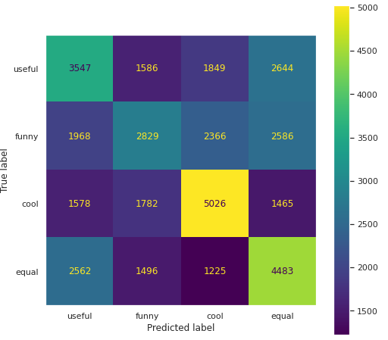
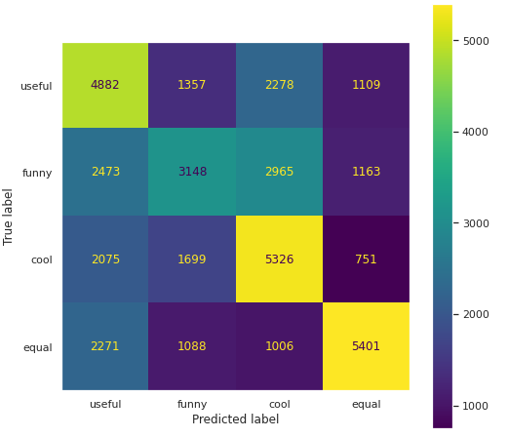
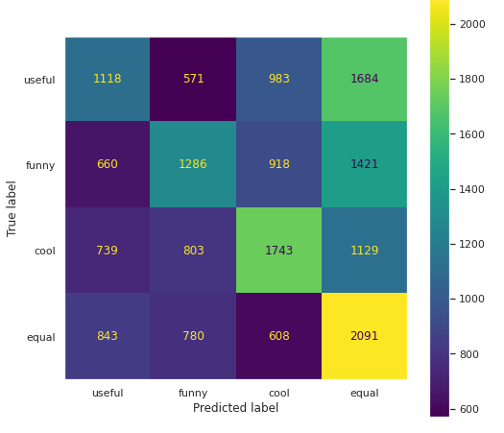
Task 1: Predict the most popular sentiment of a review
Logistic Regression
Random Forest
Creation of TFIDF features to train different machine learning classifiers
The classes were assigned to the text reviews depending on their highest score (1 = useful, 2 = funny, 3 = cool, 0 = none or equal votes)
Data balance technique was applied – under sampling
80%-20% train-test split
 | Logistic Regression | Random Forest | Naïve Bayes
F1 - score | 0.40415 | 0.47973 | 0.39454
Accuracy | 0.40739 | 0.48104 | 0.40444
Precision | 0.40441 | 0.48777 | 0.40059
Recall | 0.40739 | 0.48105 | 0.40444
Naïve Bayes

Slide 7
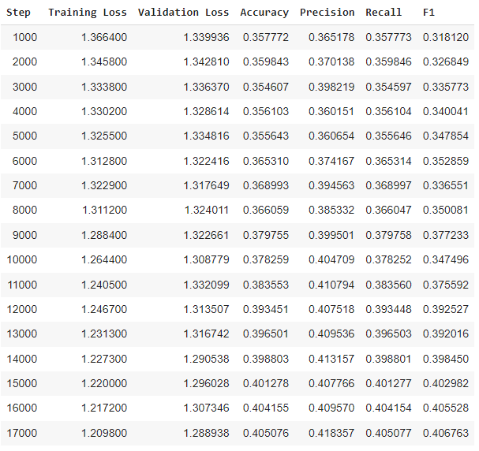
2. Fine tune BERT
BERT base uncased
Trained for 2 epochs
109,485,316 parameters were trained
Accuracy | 0.4059
Precision | 0.4197
Recall | 0.4059
F1 score | 0.4079

Slide 8
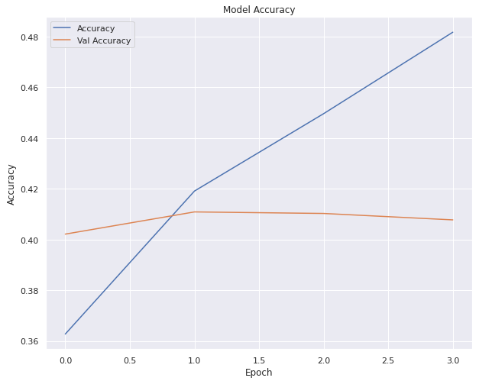
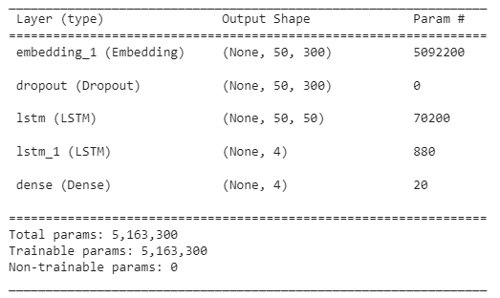
3. LSTM with Word2vec embeddings
Embeddings for the reviews were created based on word2vec with the skip-gram method
Model trained for 10 epochs, with early stopping condition
Added a dropout layer to avoid overfitting
Test Metrics
Accuracy | 0.33132
Precision | 0.34385
Recall | 0.33132
F1 score | 0.24069

Slide 9
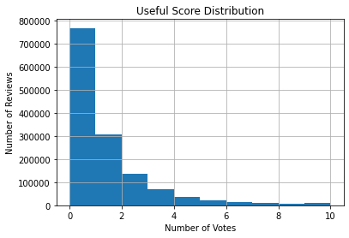
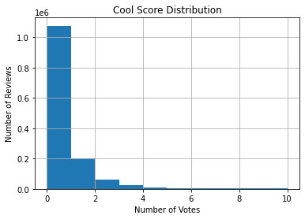
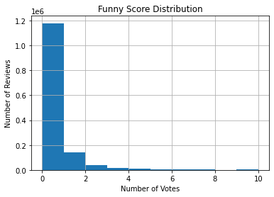
Task 2: Predict whether sentiment of a review hits a threshold
Sentiment distribution
Sentiments are significantly skewed toward 0
Threshold of value 1 is applied to adapt the unbalance distribution
No resampling on filtered sentiments
80%-20% train-test split

Slide 10
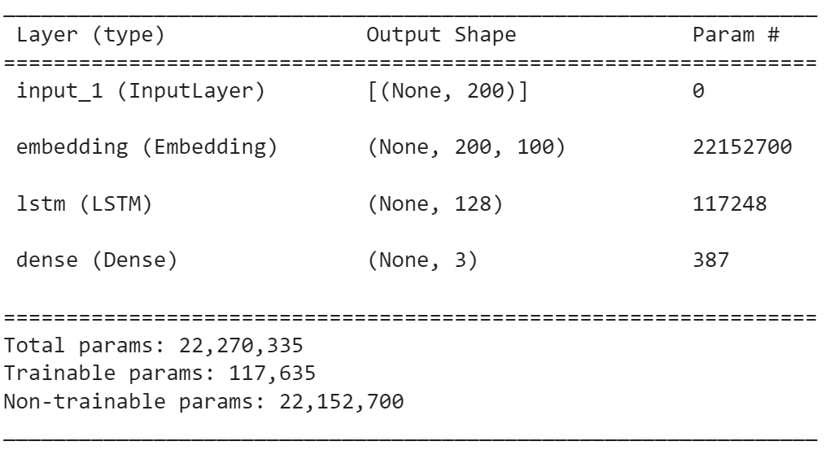
2. LSTM with GloVe word embeddings
Embeddings review with GloVe dictionary
Single output layer of 3 labels of sentiment passing threshold
Model trained for 5 epochs + batch size of 128
Used binary cross entropy to compute loss and final evaluation of the model.
Results:
Accuracy | 0.9427
F1 score | 0.5034

Slide 11
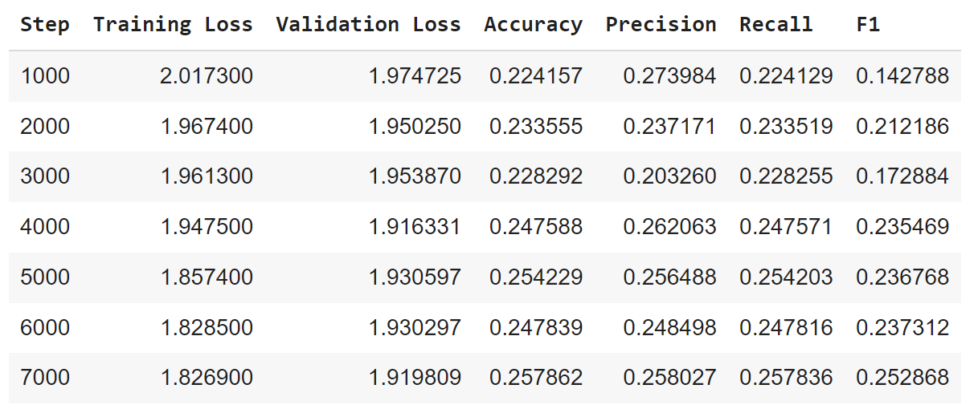
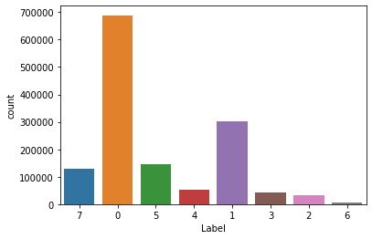
3. Multiclass classification w/ Fine-Tune BERT
Transforming 3 labels into 8 different classes (combinations of sentiment passed the threshold)
Under-sampling to balance class distribution
Model trained for 2 epochs + batch size of 8
Label Frequency
Test Metrics
Accuracy | 0.2596
Precision | 0.2566
Recall | 0.2596
F1 score | 0.2541
U – Useful | F – Funny | C – Cool
0 –None | 1 – U | 2 – F | 3 – C | 4 – UF | 5 – UC | 6 –FC | 7 - All

Slide 12
Task 3: Predict the sentiment ratings of a review
Undersampled to get balanced combinations of sentiment ratings
Since so many reviews had zero votes for a given sentiment, focused on getting an even distribution of zeros across the data
Split data into eight categories based on whether a sentiment rating has zero votes (see figure)
Took 1,000 samples from each category because the smallest category had about 1,200 values and because we did not have enough RAM to process more than 8,000 samples
80%-20% train-test split
Category Distribution
Useful | Funny | Cool
None | None | None
At least one | None | None
None | At least one | None
None | None | At least one
At least one | At least one | None
None | At least one | At least one
At least one | None | At least one
At least one | At least one | At least one

Slide 13
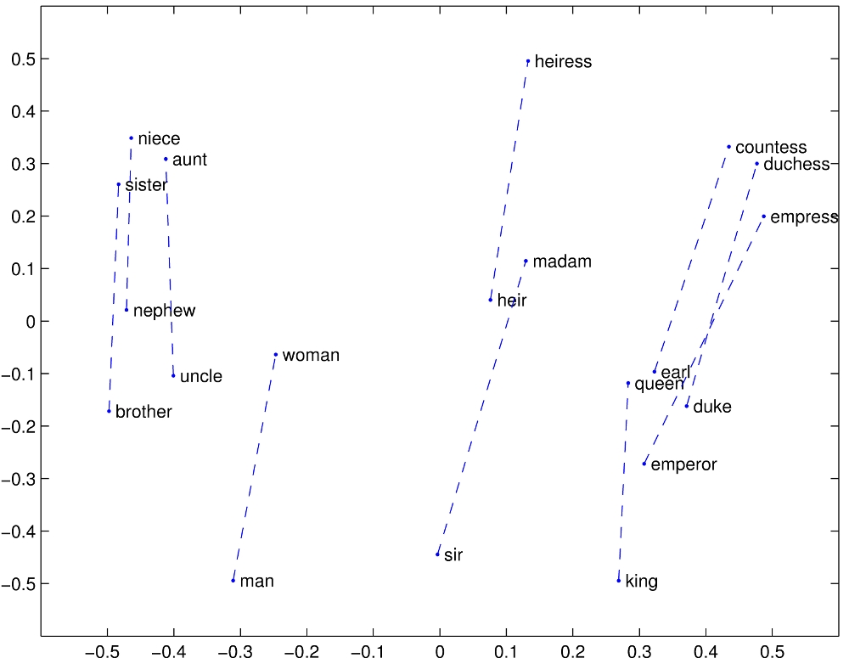
Input Data
First 256 words of review converted into GloVe word embeddings with 100 dimensions
Star rating as an integer between 1 and 5
User useful, funny, and cool scores converted to decimal ratios
Each user has scores tied to how others have rated their reviews, but unsure if magnitude of these scores was directly tied to how many sentiment upvote of their reviews
Ignore the magnitude of scores by recording the ratio of useful, funny, and cool sentiments.
Example:
user_useful: 0.1, user_funny: 0.4, user_cool: 0.5

Slide 14
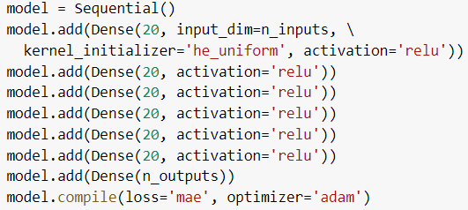
Model
Used a Keras sequential model
Added a number of dense layers, each with an output size of 20 and using rectified linear activation
Optimizes through stochastic gradient descent using the Adam algorithm
Used mean absolute error to compute loss and for final evaluation of the model's results

Slide 15
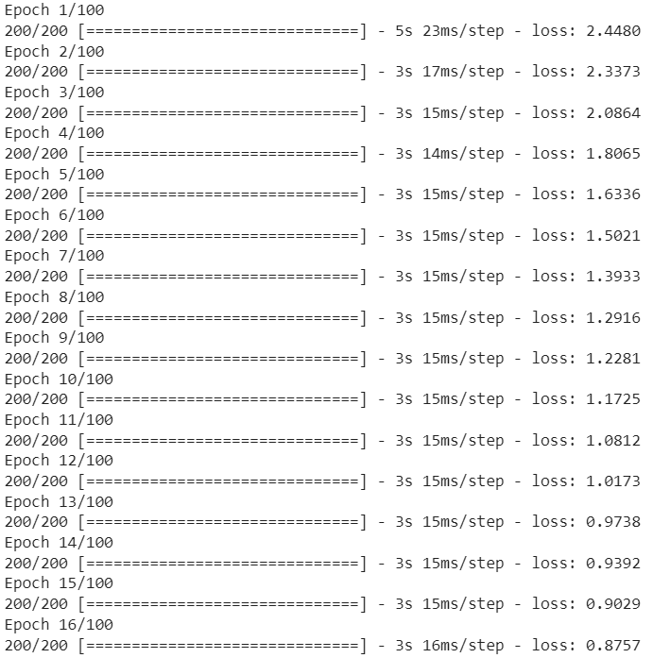
Training and Results
Ran with 100 epochs and 200 steps per epoch
Tried training all three sentiments together and getting a combined output, but ended up training and evaluating the three separately to get individual mean absolute errors
Results:
Useful - MAE: 2.653
Funny - MAE: 1.657
Cool - MAE: 1.864

Slide 16
Limitations
Only able to work with a small subset of Yelp data due to memory limitations
Lack of computational power limited the types and complexity of models we could try
For task 3, input data does not include anything that indicates how many people saw a given review, making it difficult to guess the magnitude of sentiment ratings
Example: model may determine that a review is funny, but nothing in the data shows whether it should have 5 or 50 funny ratings
It is difficult to balance data that has multiple classes
We took a simple approach that may not have given us an ideal distribution of data

Slide 17
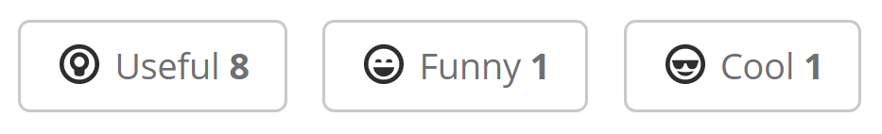
Conclusions
Task one: 48.10% best accuracy
Task two: 94.27% best accuracy
Task three: mean absolute errors of 2.653 (useful), 1.657 (funny), and 1.864 (cool)
We anticipated having the highest accuracy on task one and thought accuracy would decrease as tasks became more complex
This pattern prove otherwise between tasks one and two
It is difficult to judge how accurate task three is relative to the others since it predicts continuous values instead of categorical ones

Slide 18
Future Work
Use the WPI Cluster to train our models
Implement bidirectional LSTM architectures to obtain better results
Incorporate additional data such as review count or number of check ins for a business to help estimate sentiment ratings

Slide 19
Thank you

